Slide 1
COMP0118 Analysis of MRI T2 Relaxometry
FRANCESCO SERACINI – CHONGPO SHAO – PRAGYA SINHA – ETHAN STEPHENSON – XINYU TIAN

Slide 2


Introduction
Aim
Estimate brain tissue T2 relaxation values using MRI images.
Why T2 Relaxation?
Reflects tissue differences (healthy vs. diseased).
Essential for clinical diagnosis (tumors, inflammation) and neurological studies.
Single T2 Component
Two T2 Components (complex tissues)
Data
Six datasets with multi-echo T2 data, echo times, brain masks, segmentation, and parcellation files for analysis.

Slide 3
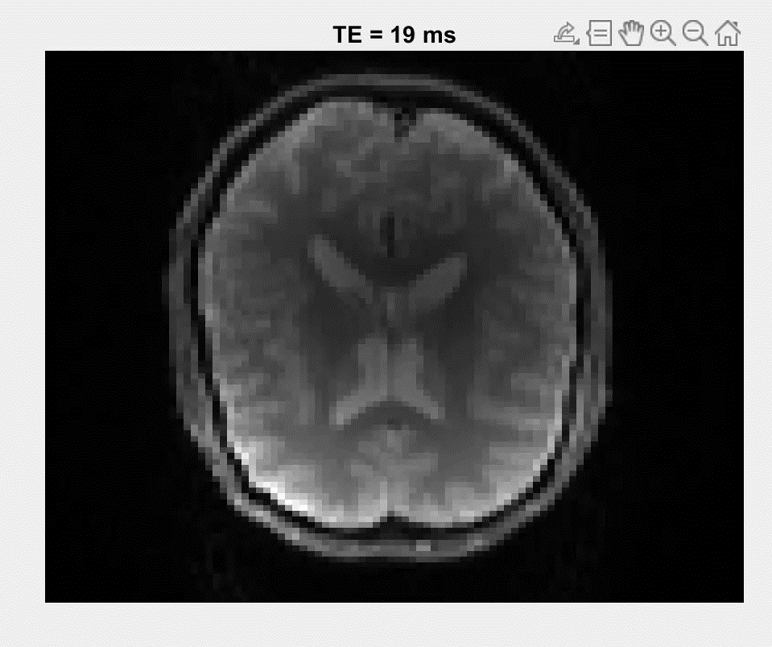
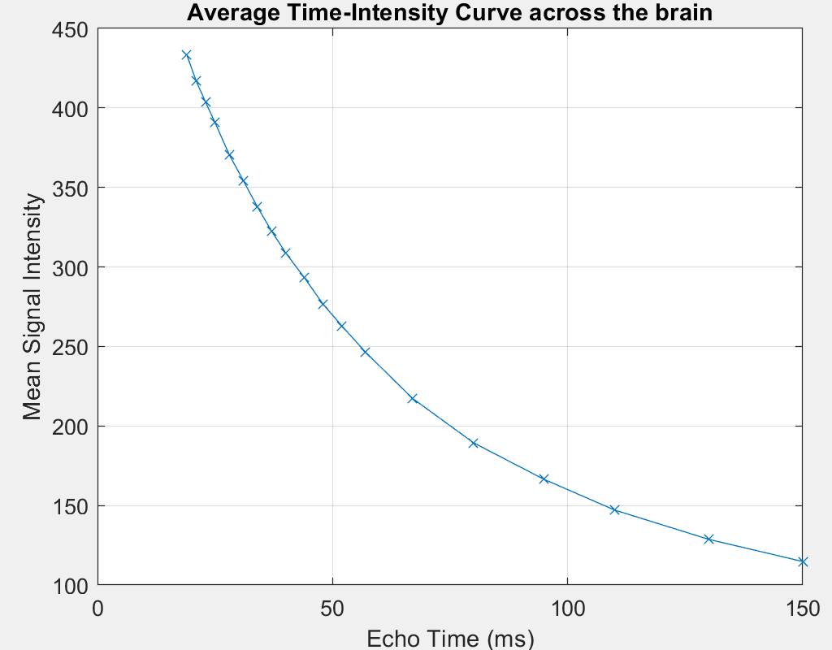
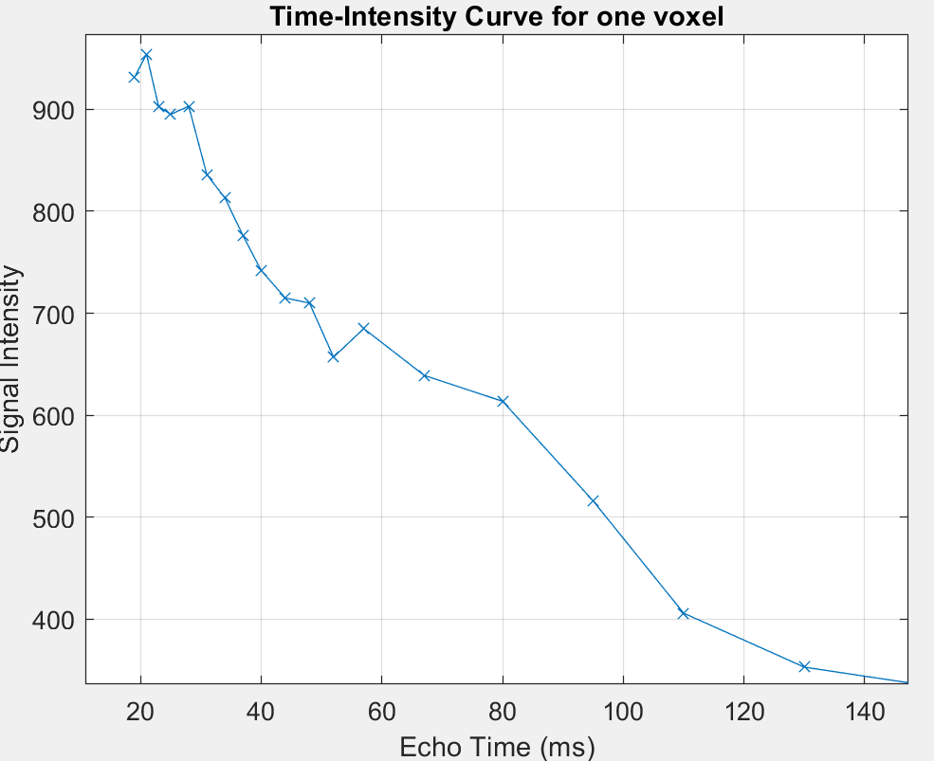
T2 Decay and Image Acquisition Problems
Signal intensity at different echo-times
Imaging Problems:
Noise
Patient motion
Different tissue compartments

Slide 4
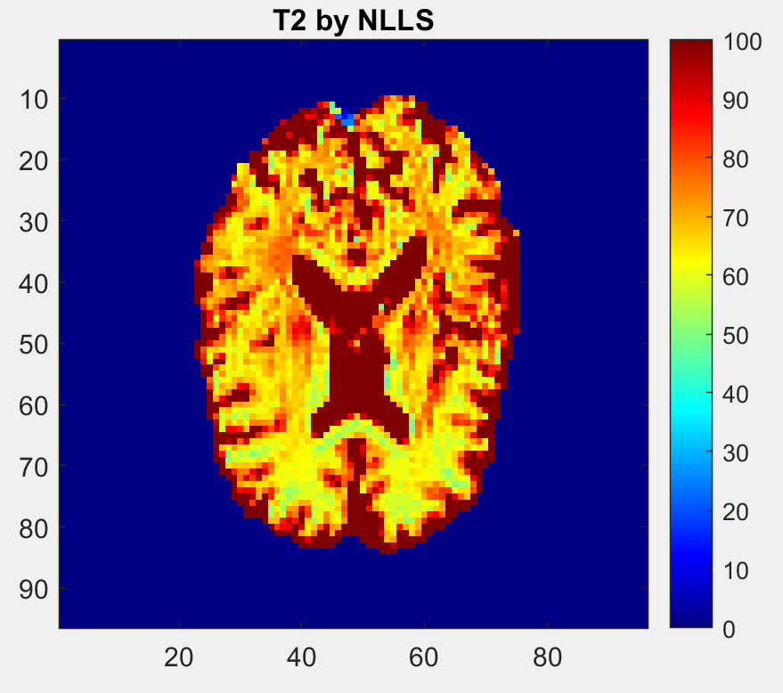

T2 Estimate
ALGORITHM | RESIDUAL ERROR | COMPUTATIONAL TIME
Linear Least-Squares | 338.16 | 1.15 seconds
Weighted Least-Squares | 299.02 | 3.11 seconds
Non-Negative Least-Squares | 338.90 | 2.72 seconds
Non-Linear Least-Squares | 289.92 | 33.64 seconds
T2 Estimates from NLLS

Slide 5

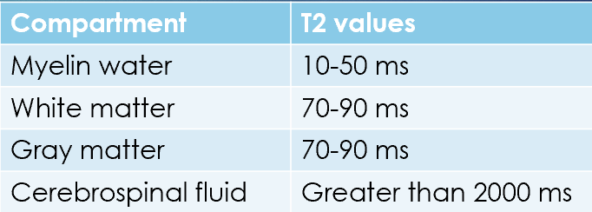
Multi-compartments model
Voxels containing a mixture of different tissues, do not conform to a single-exponential model
T2 values by brain compartment ([1])
[1] Dingwall et al. T2 relaxometry in the extremely-preterm brain at adolescence

Slide 6
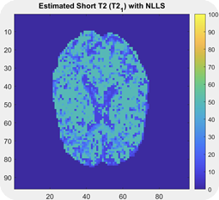
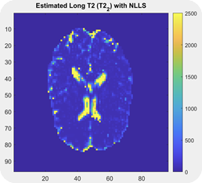
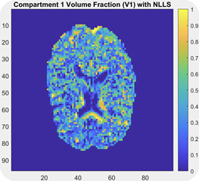
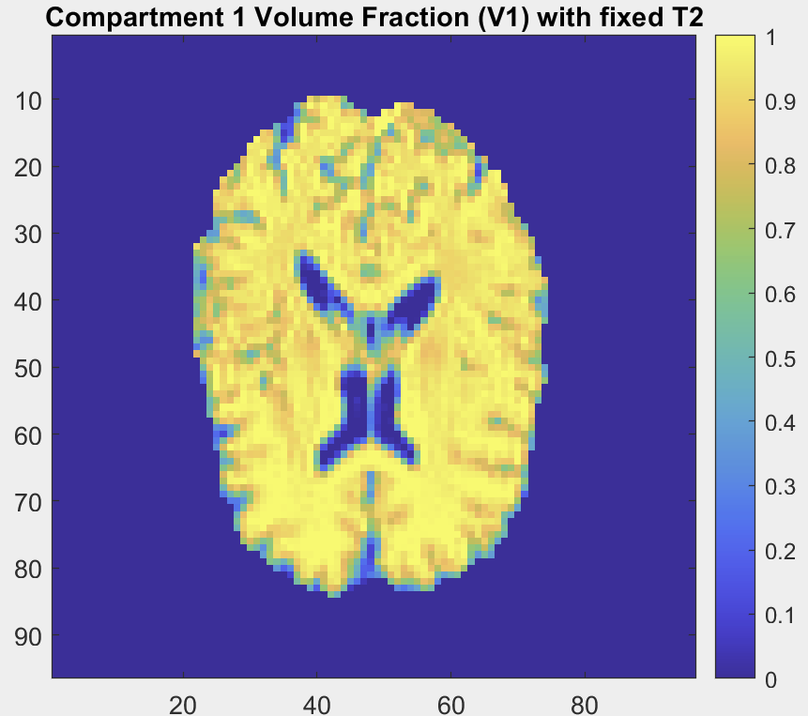
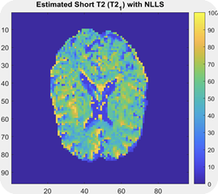
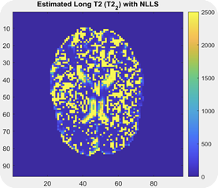
TWO-COMPARTMENTS MODEL
T2_1 = [10, 50] T2_2 = [70, 2500]
T2_1 = [10, 90] T2_2 = [90, 2500]
Volume fraction map comparison between different models
T2 maps under different constraint strategies

Slide 7
Two compartments model
The average value and confidence intervals of CSF, GM, WM
STRUCTURE | Parameter | Mean (ms) | Confidence intervals (ms)
WM | T2 (short) | 28.412 | 28.307 - 28.516
 | T2 (long) | 76.297 | 76.067 - 76.527
 | V | 0.186 | 0.186 - 0.186
GM | T2 (short) | 29.747 | 29.621 - 29.874
 | T2 (long) | 102.204 | 101.373 - 103.035
 | V | 0.161 | 0.160 - 0.162
CSF | T2 (short) | 31.613 | 31.221 - 32.004
 | T2 (long) | 1968.43 | 1961.052 - 1973.81
 | V | 0.0173 | 0.0171 - 0.0176
Notes:
First, the three regions have similar short T2 components, around 30ms, which is in the range of typical myelin water.
The WM region shows a long T2 component of about 76 ms, and a myelin water fraction (V1) of 0.186, which is consistent with the value in the reference. It shows the highest volume fraction V, which is consistent with its high myelin content.
The GM region has a significantly longer long T2 component of 102ms, and the myelin water fraction drops to 0.16. Reflecting the lower myelin content of gray matter.
The long T2 component of CSF reaches around 2000ms, which is much higher than other tissues, consistent with its fluid characteristics.
The short T2 component of CSF is around 31ms, which is larger than expected, probably due to the partial volume effect of the adjacent tissue to the CSF.
The confidence intervals for all measured parameters are narrow, indicating that the estimates have good statistic stability.

Slide 8
Conclusion
Further research directions
Two compartment T2 models are a better fit with lower errors
This will be extended in future work with multiple compartment models
The T2 models will be expanded to better account for noise and applied to the study of preterm brains
AIC = 2k - 2 ln(L)
Model | Error | AIC
T2 - NLLS - 1 compartment | 289.92 | 583.84
T2 - NLLS - 2 compartments (fixed) | 273.44 | 554.88
T2 - NLLS - 2 compartments | 198.08 | 404.16
Comparison between different models

